Slide 1
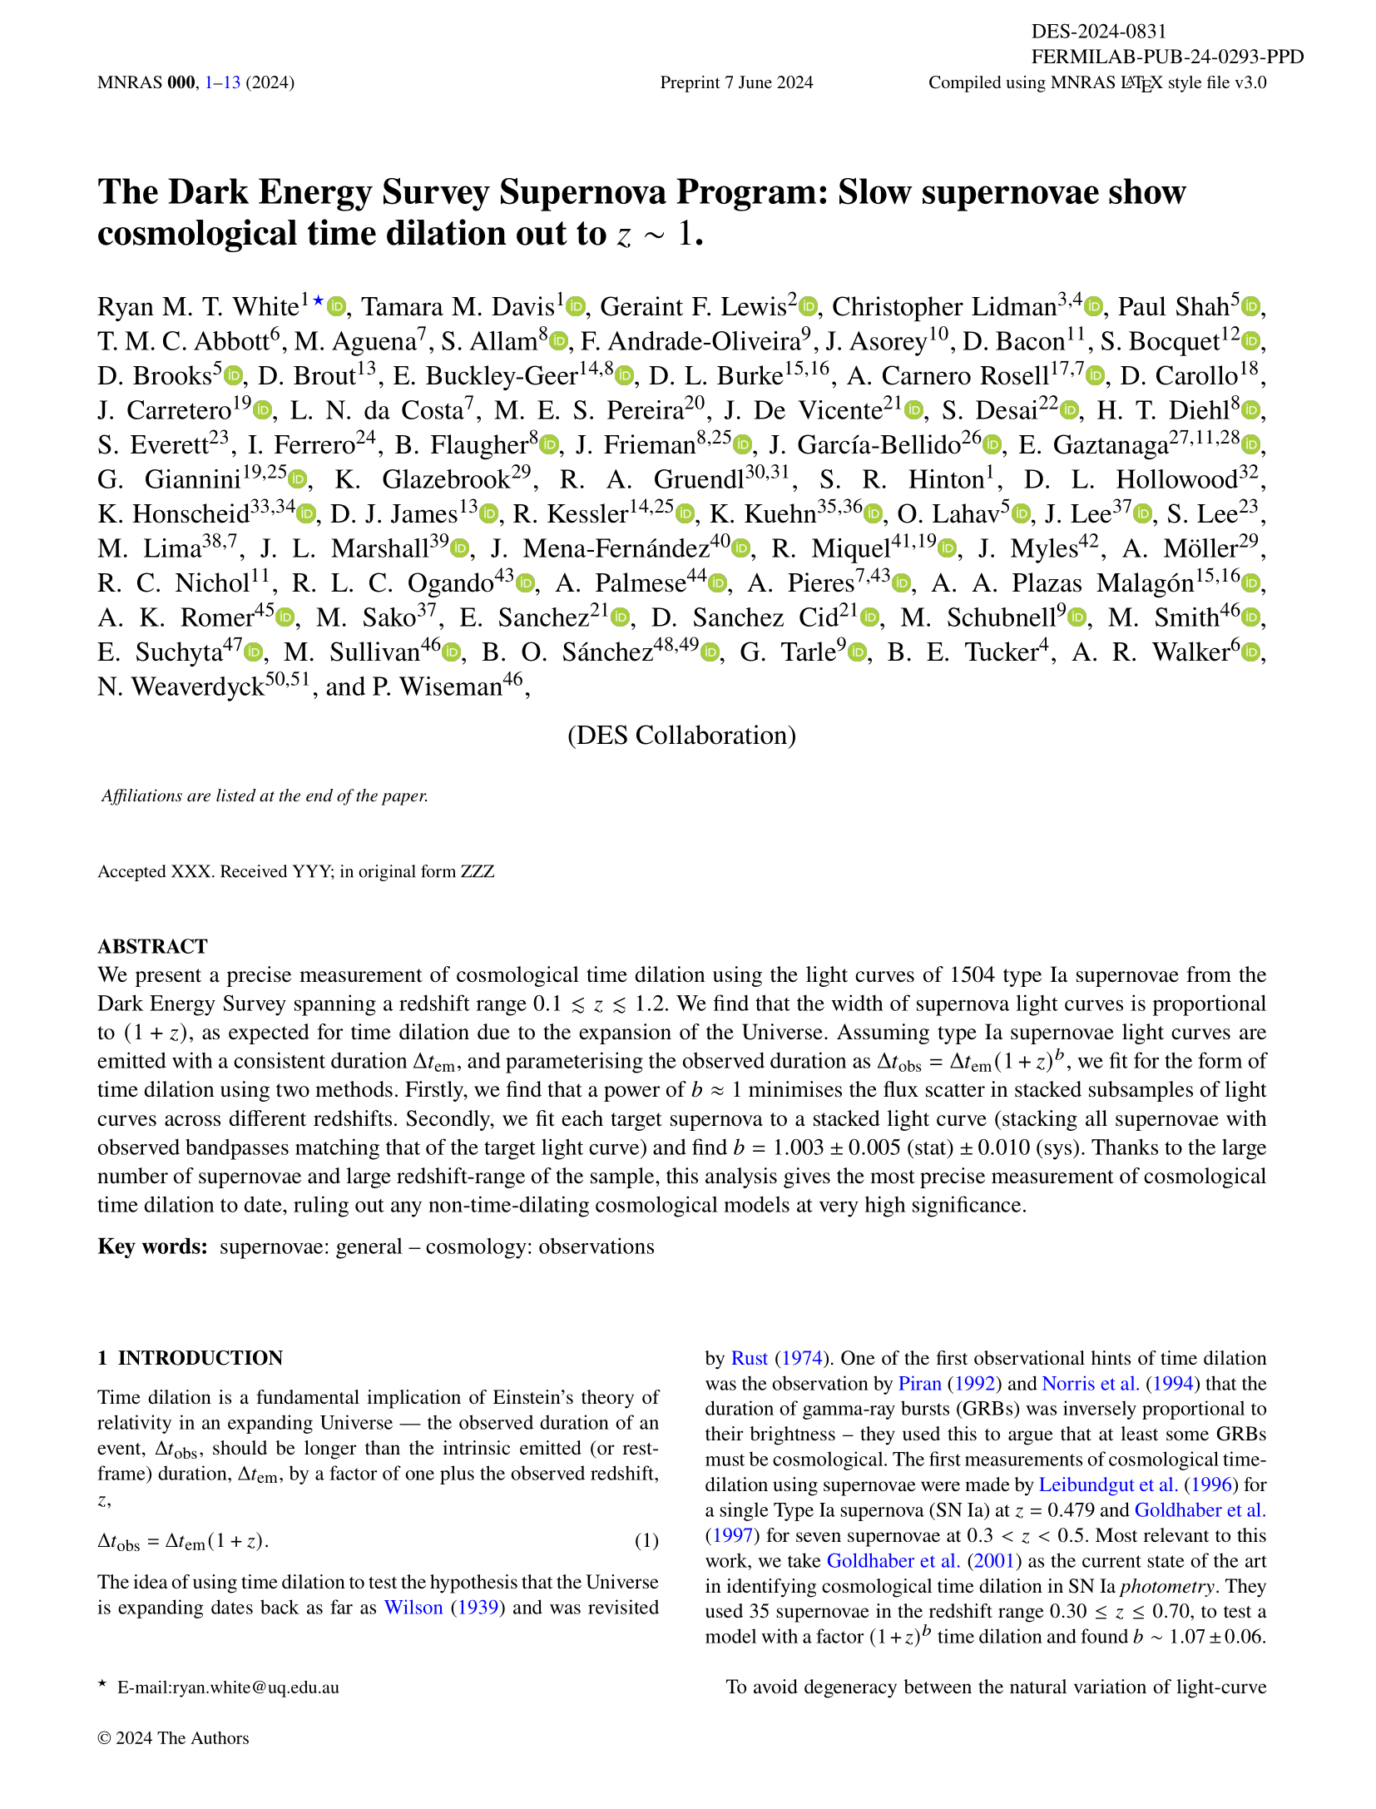
Time slows down in the distant Universe!
This work is the combined effort of a *lot*
of very smart people…
So many people from so many places that we had to put the places at the end of the paper!
Here’s the tl;dr…
For almost 100 years we’ve known that the Universe is expanding. Our models of an expanding Universe predict that a very far away clock will tick slower than one right next to us – something called cosmological time dilation. In this paper we treat exploding white dwarf stars like clocks, using more of these and at higher distances than ever before to measure time dilation. Using the most data-driven approach so far, we find… pretty much what we expected! With the quality of the data from our collaboration, the Dark Energy Survey, this is the most precise detection of cosmological time dilation so far.
Here’s the background:
What we’re looking for in the paper isn’t a new idea – using Type Ia supernovae as clocks was proposed 85 years ago! Lots of people have used these and other transient light sources to quantify time dilation before…
Cosmological time dilation is yet *another* prediction that can be traced back to Einstein!

Slide 2
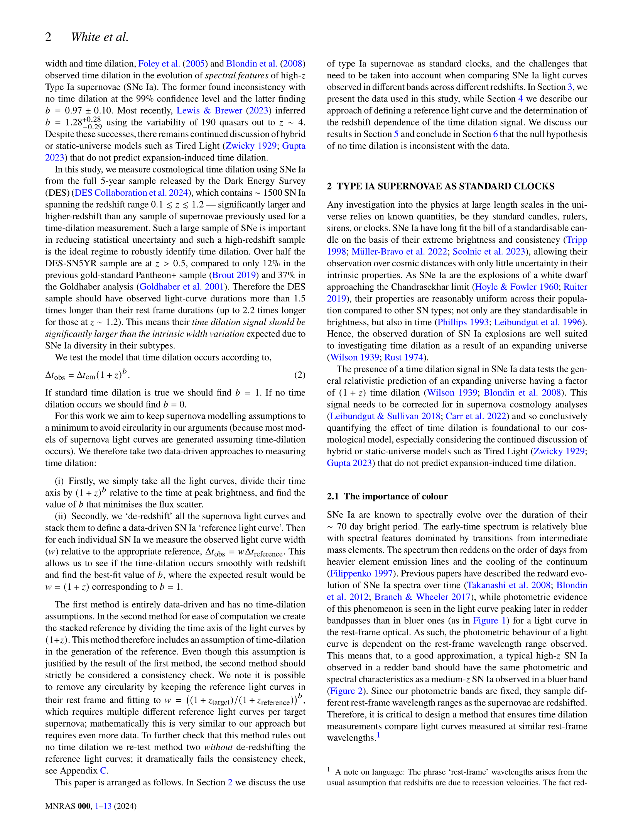
… seriously, this is something that lots of smart people have looked at before!
It’s important to use the most distant supernovae possible for these types of studies. The further the supernova is, the stronger the time dilation signal! This lets us find the signal amongst the noise.

Slide 3
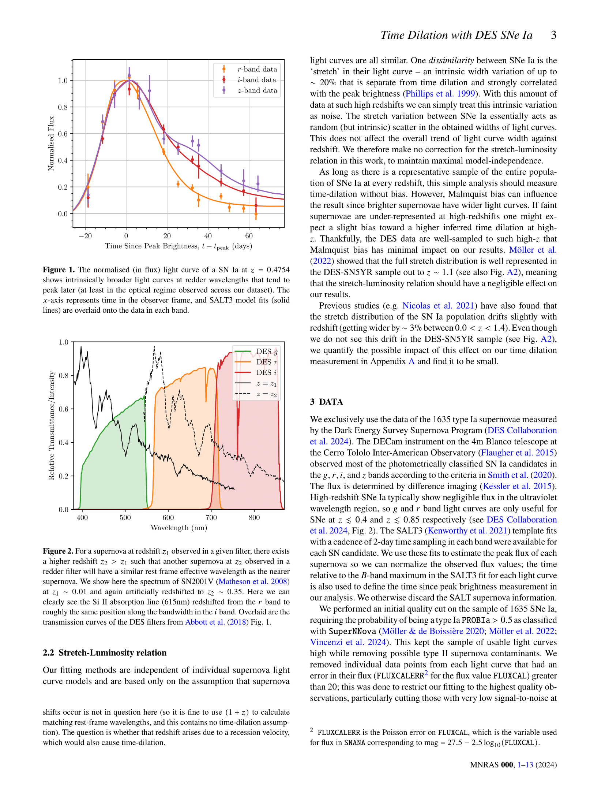

Slide 4
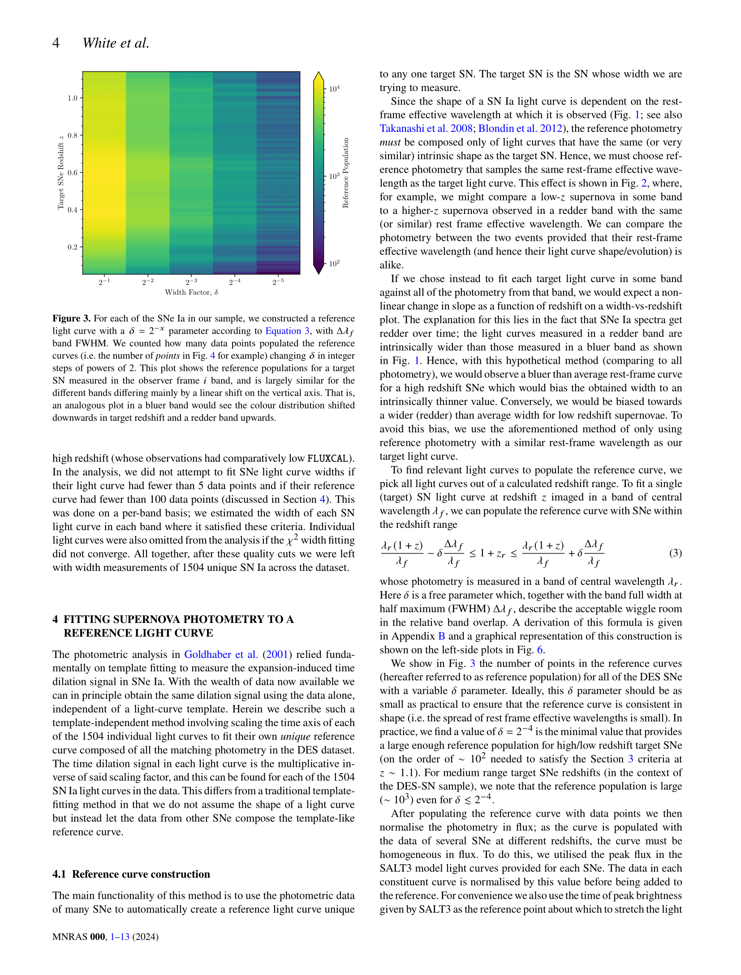

Slide 5
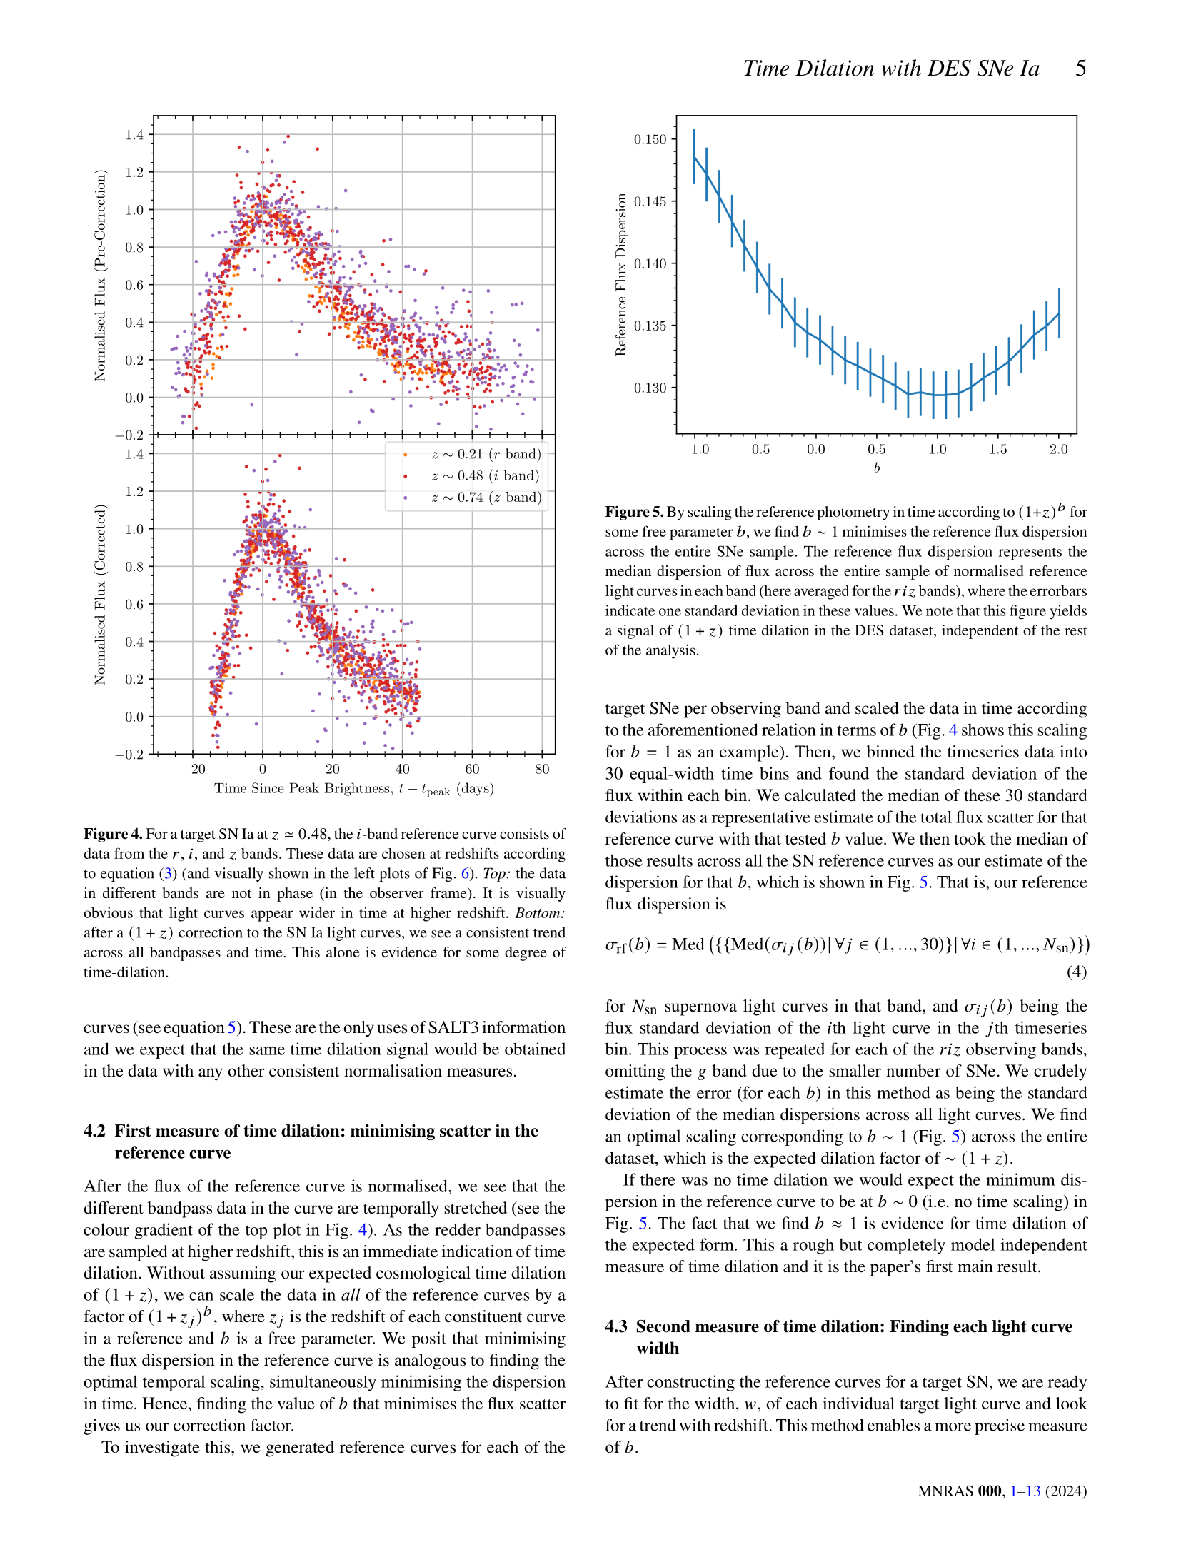

Slide 6
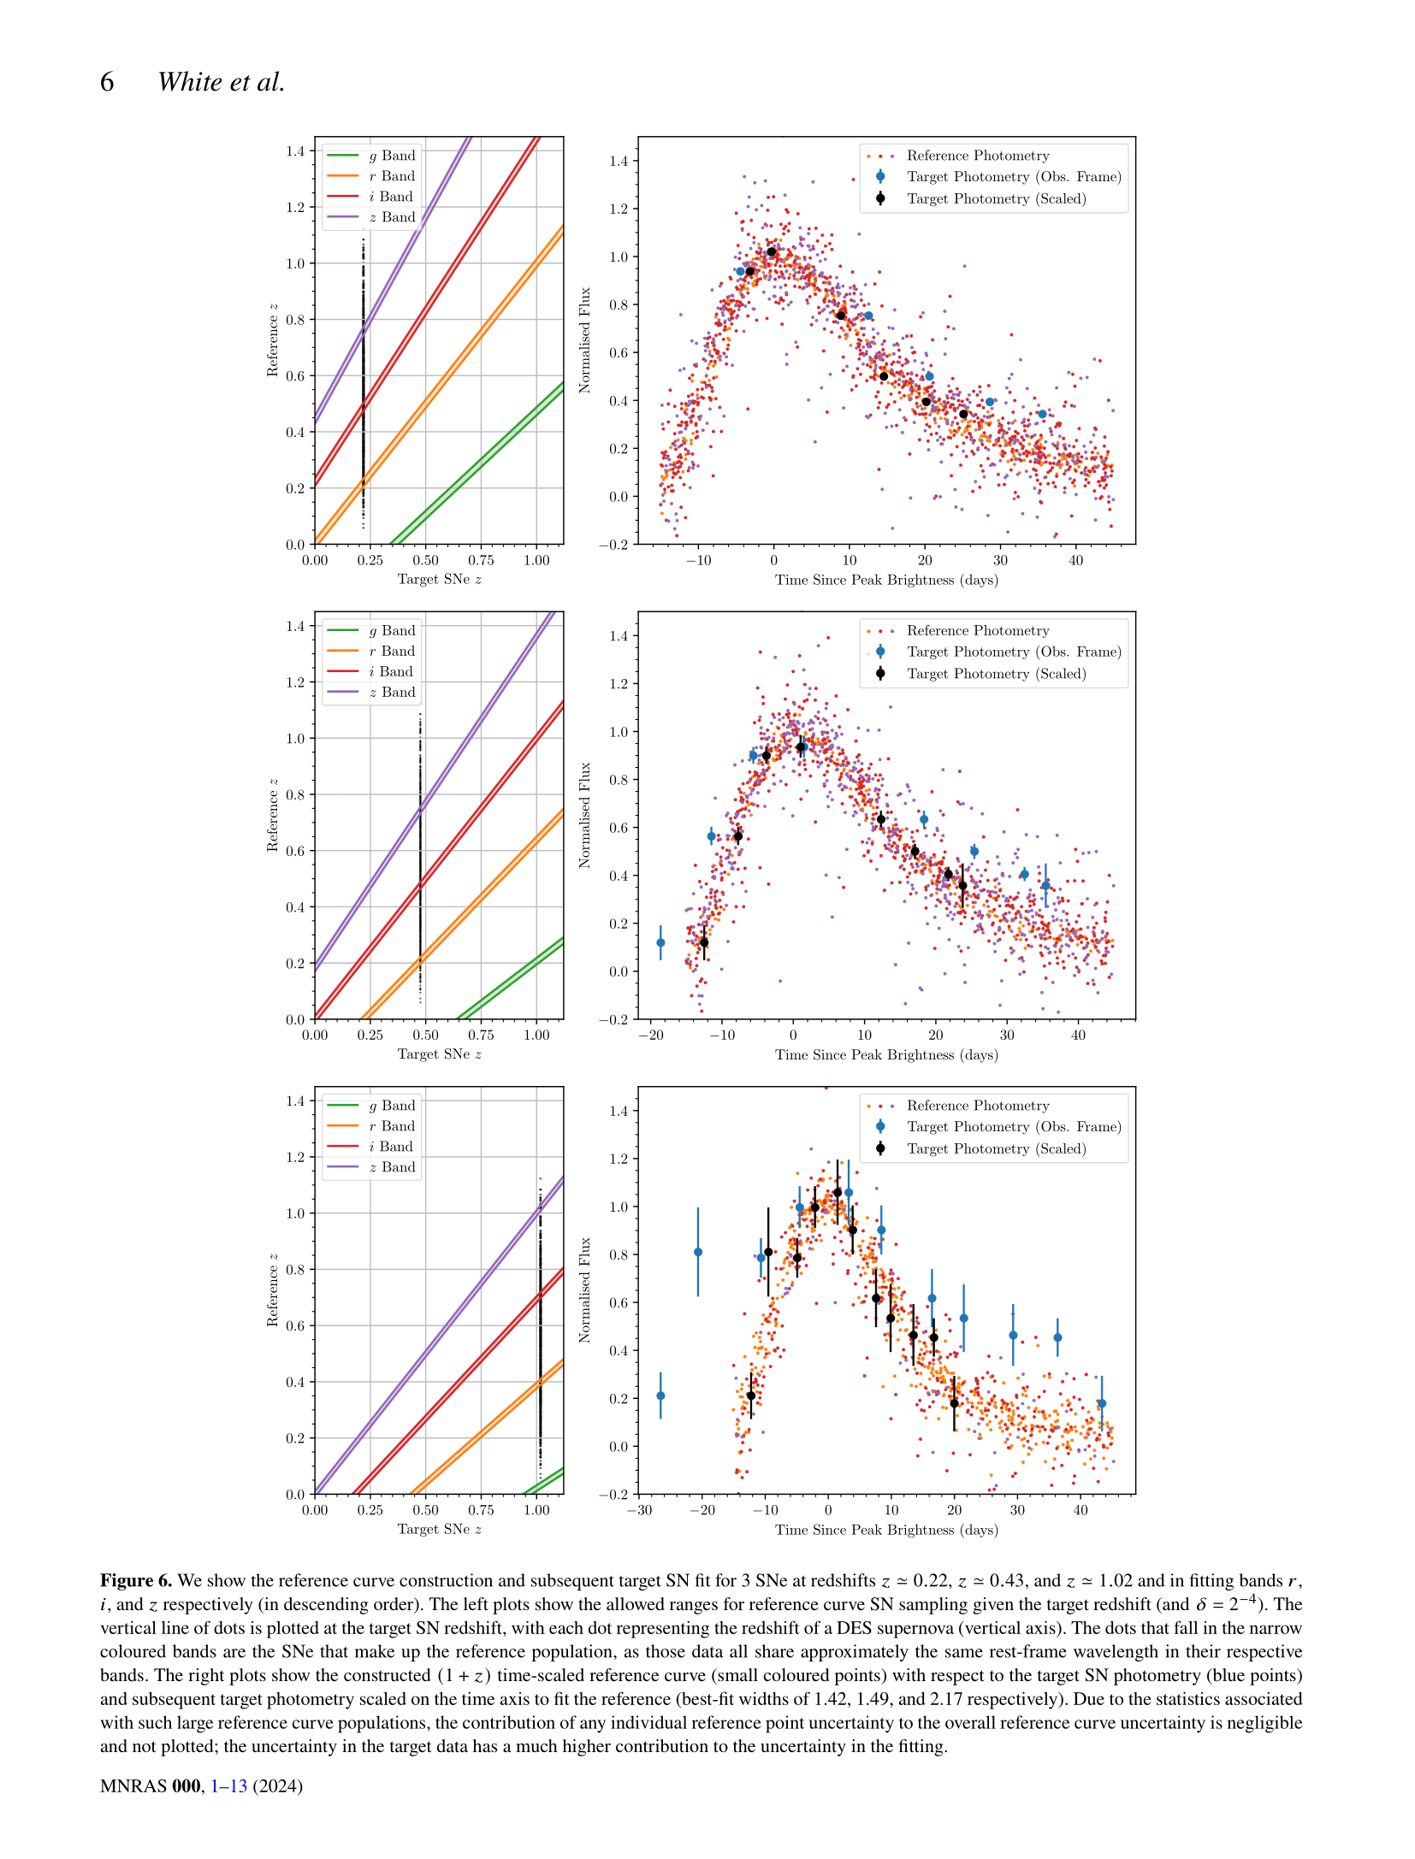

Slide 7
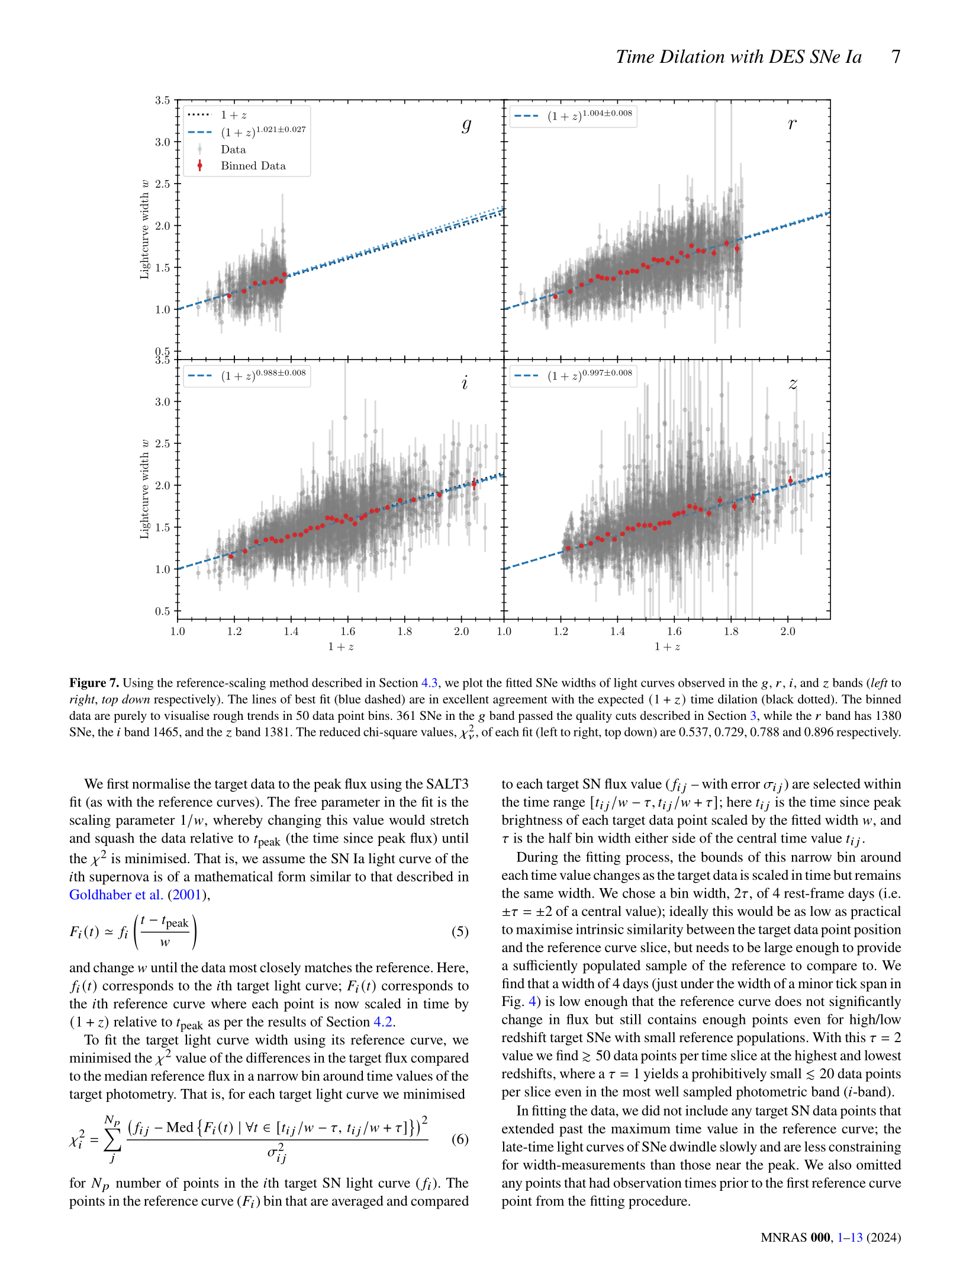

Slide 8
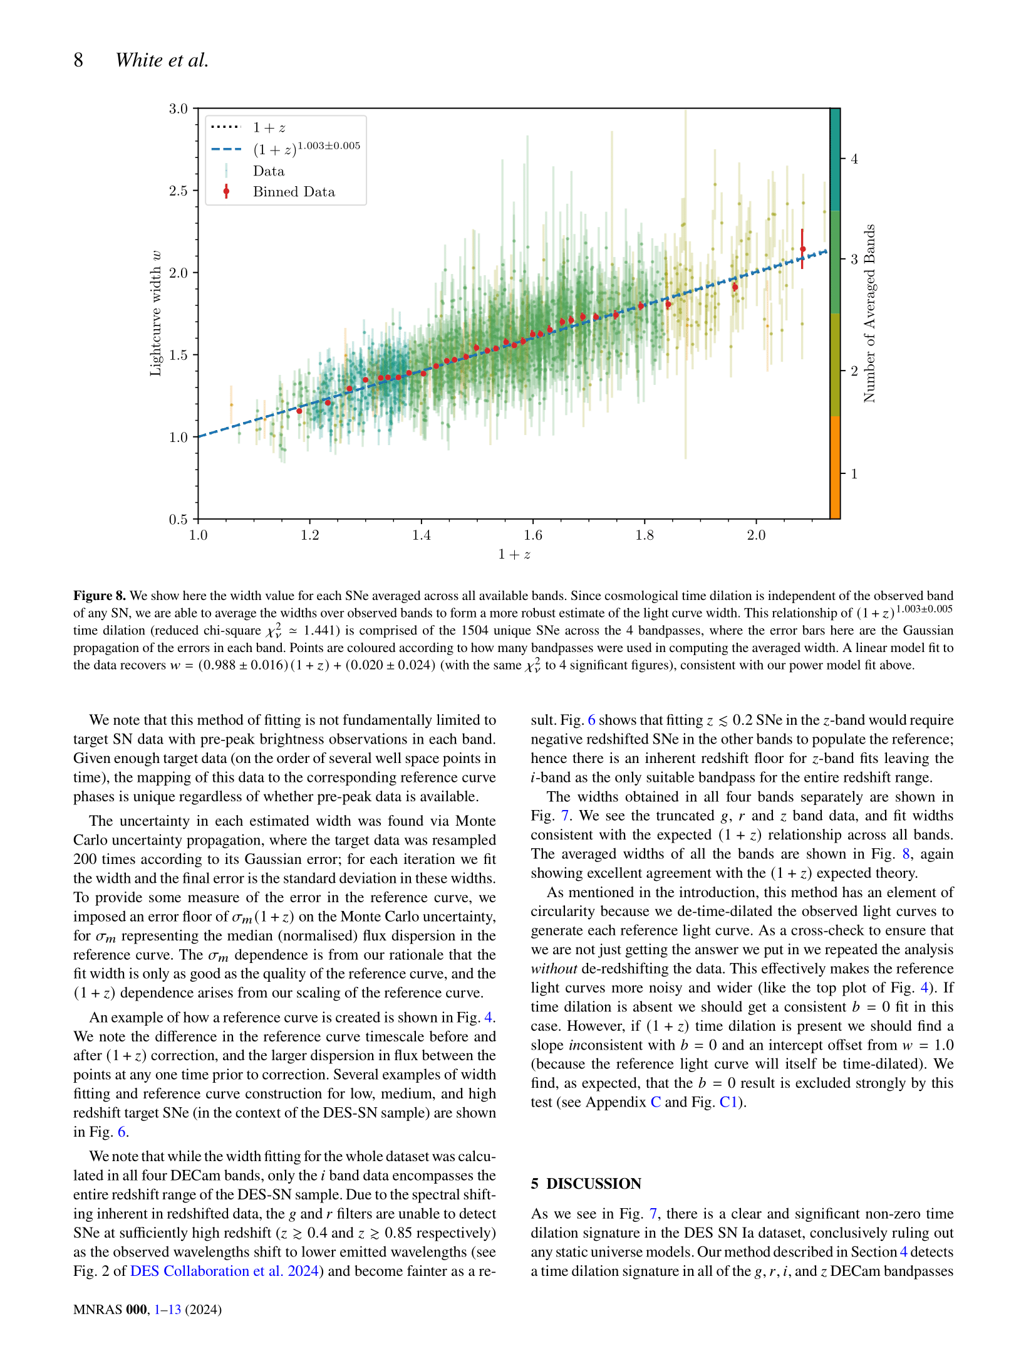

Slide 9
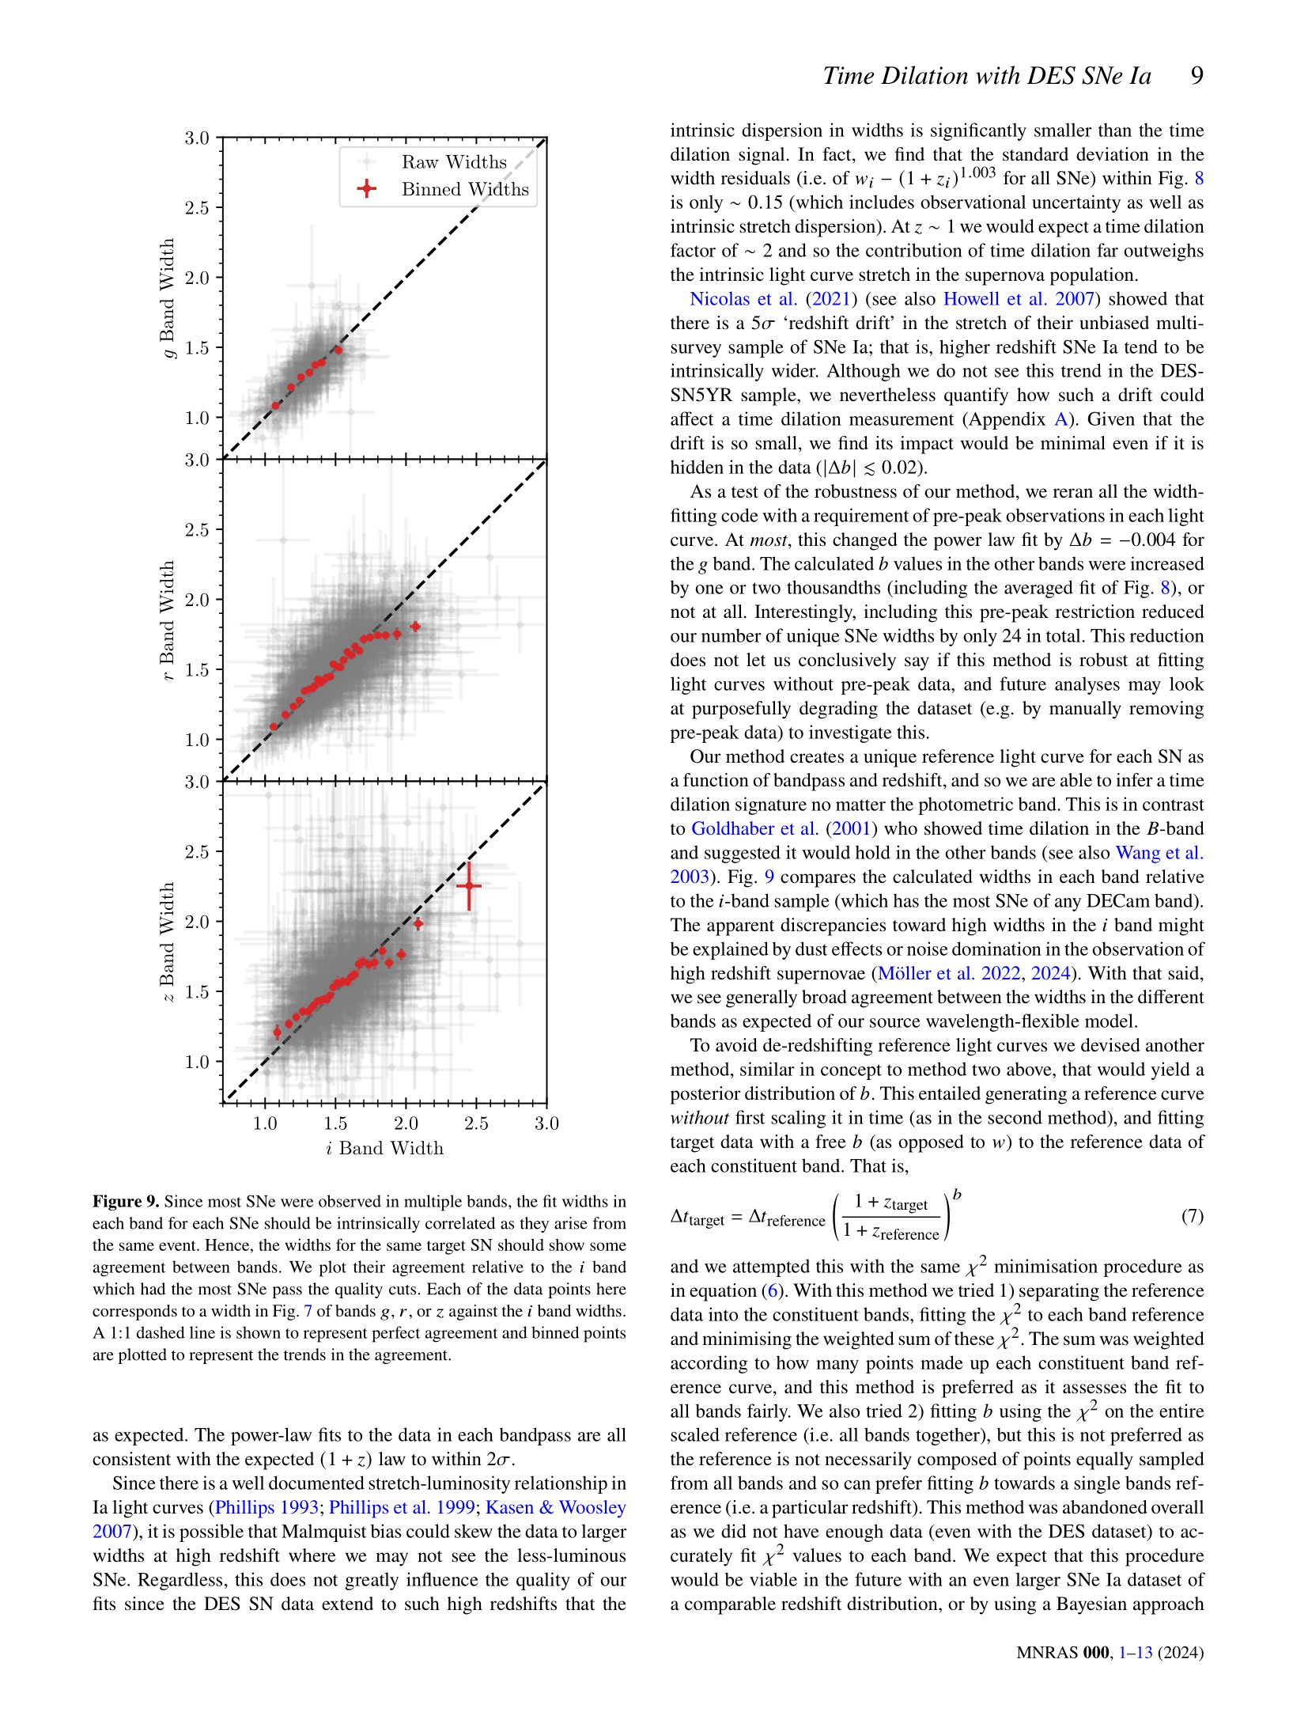

Slide 10
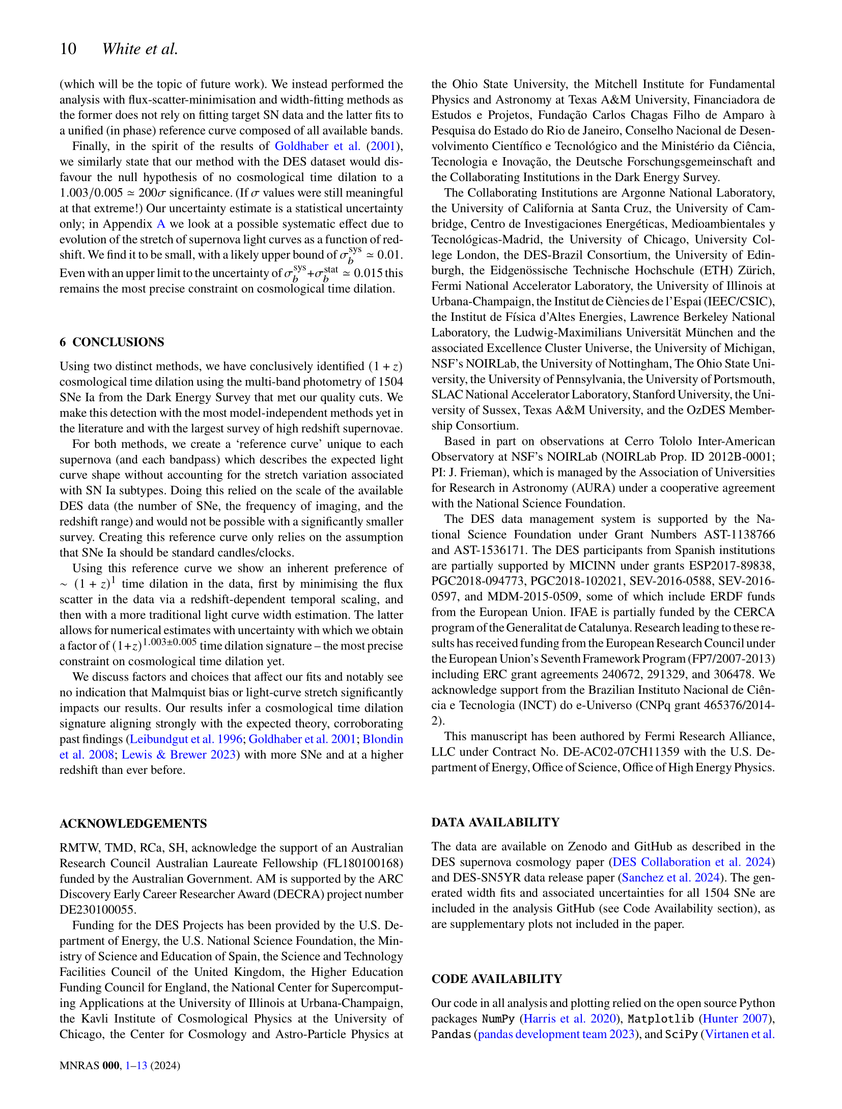

Slide 11
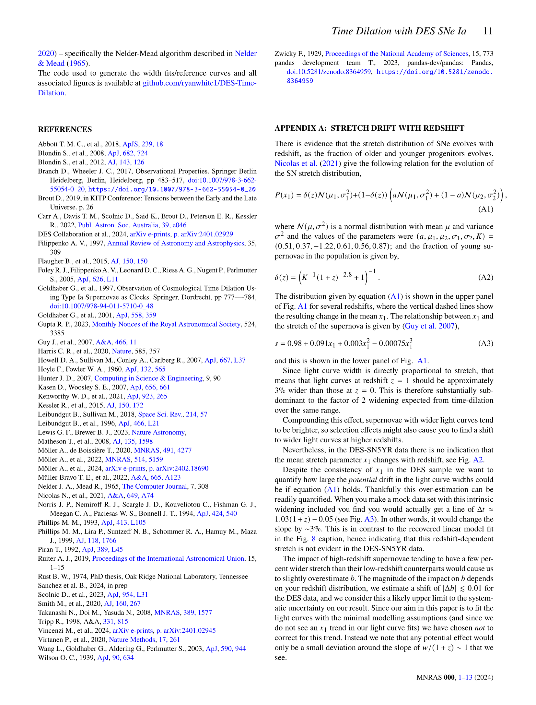

Slide 12
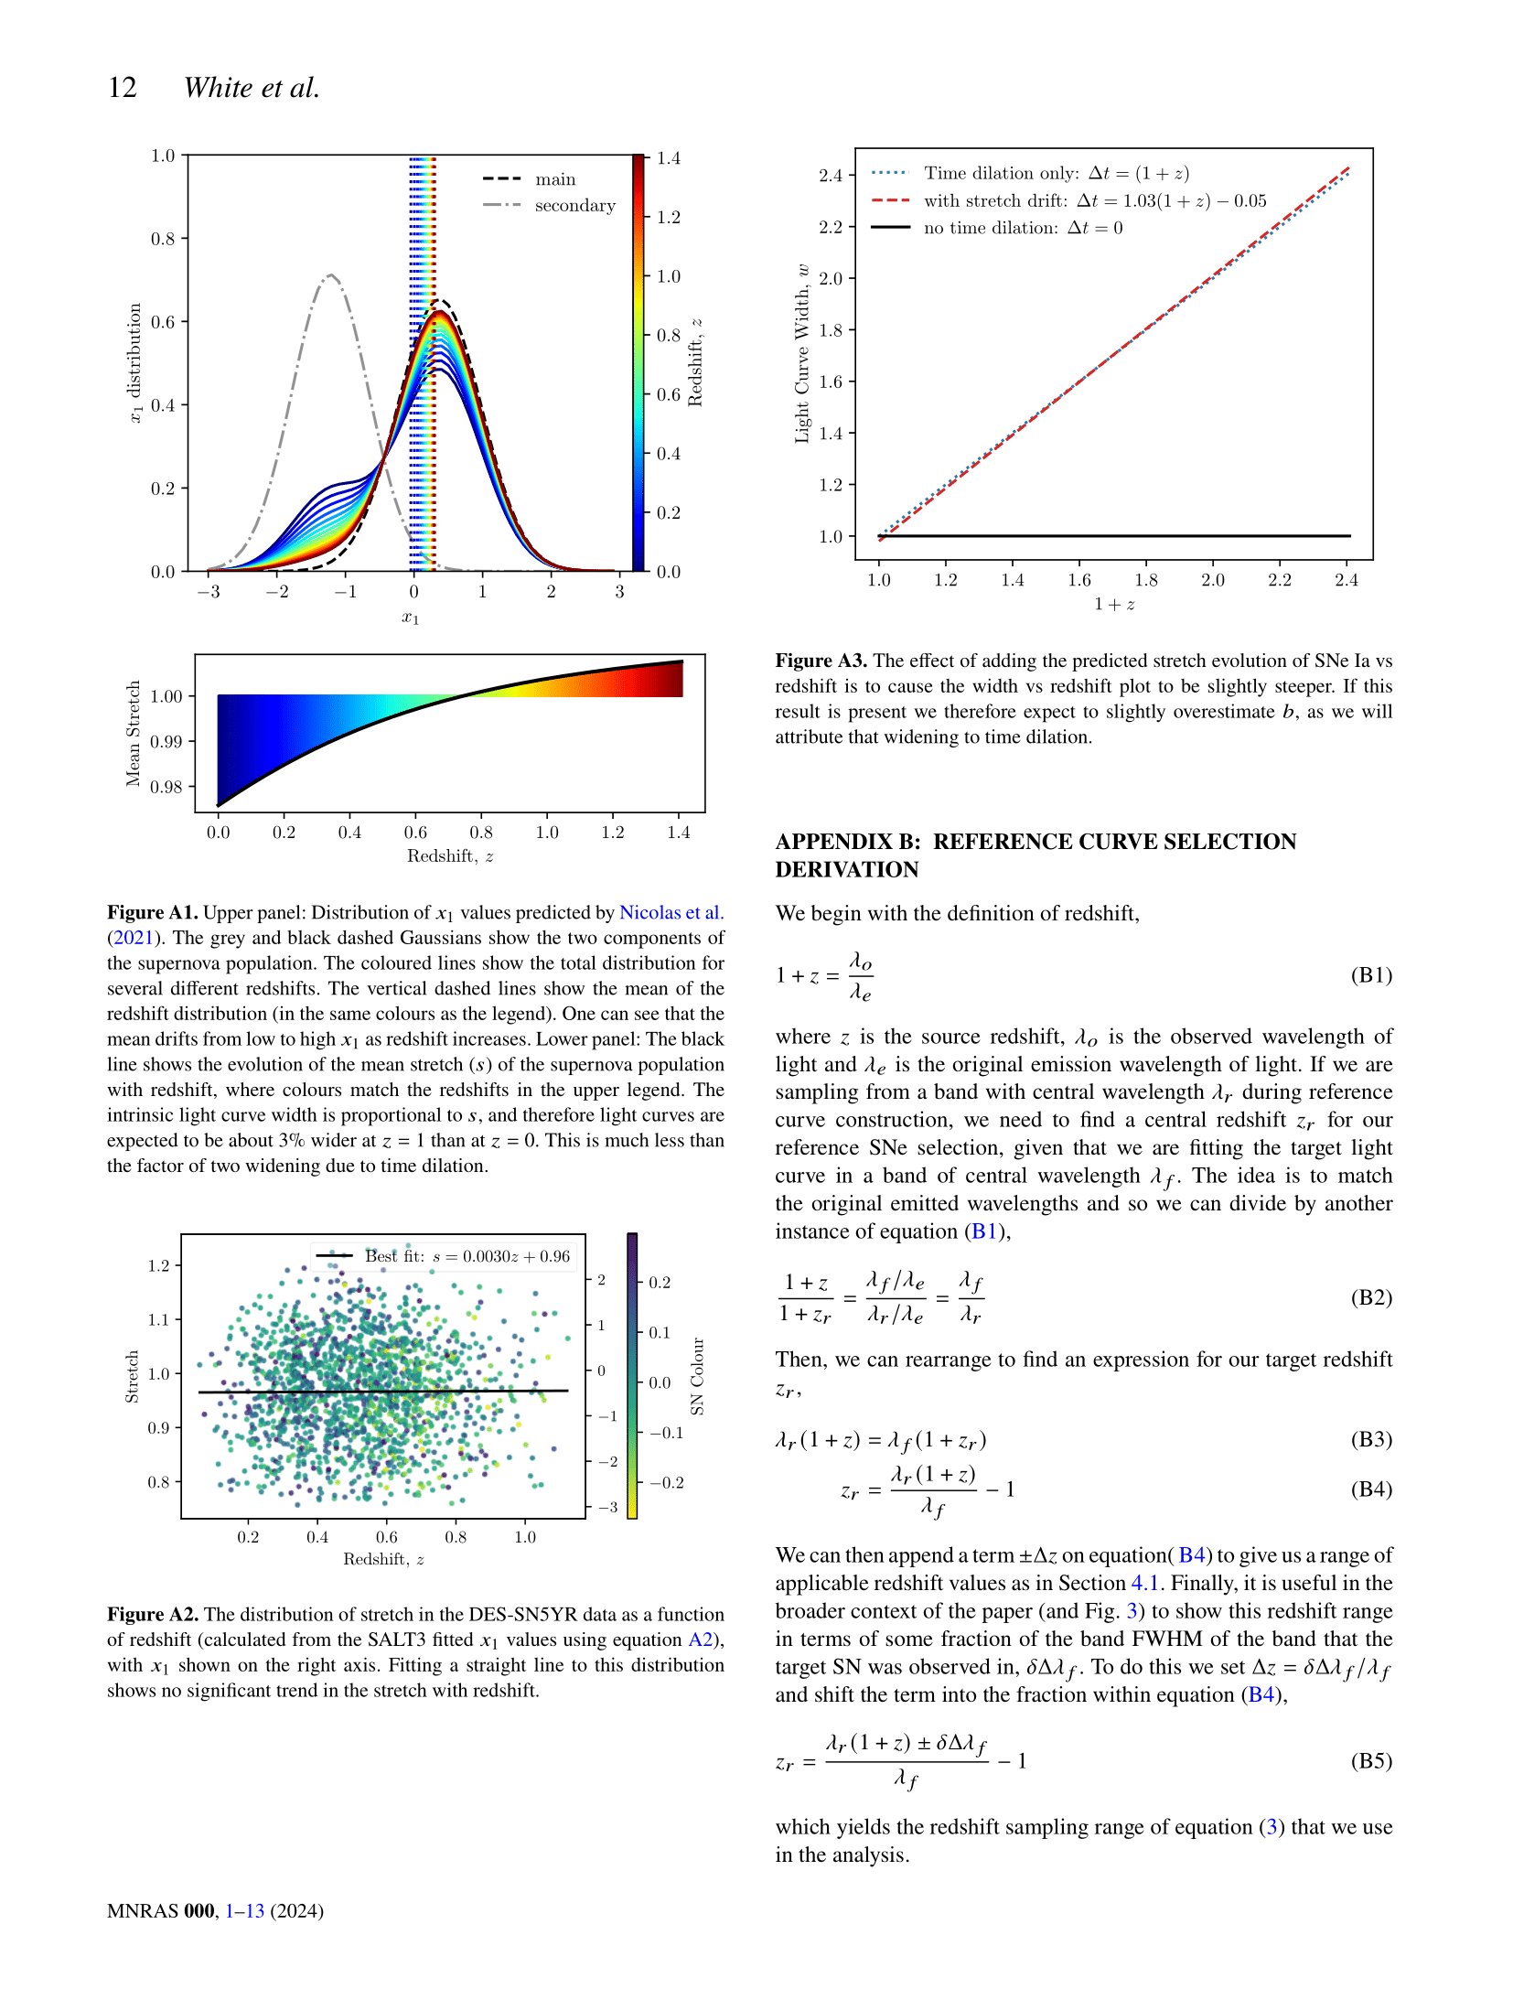

Slide 13
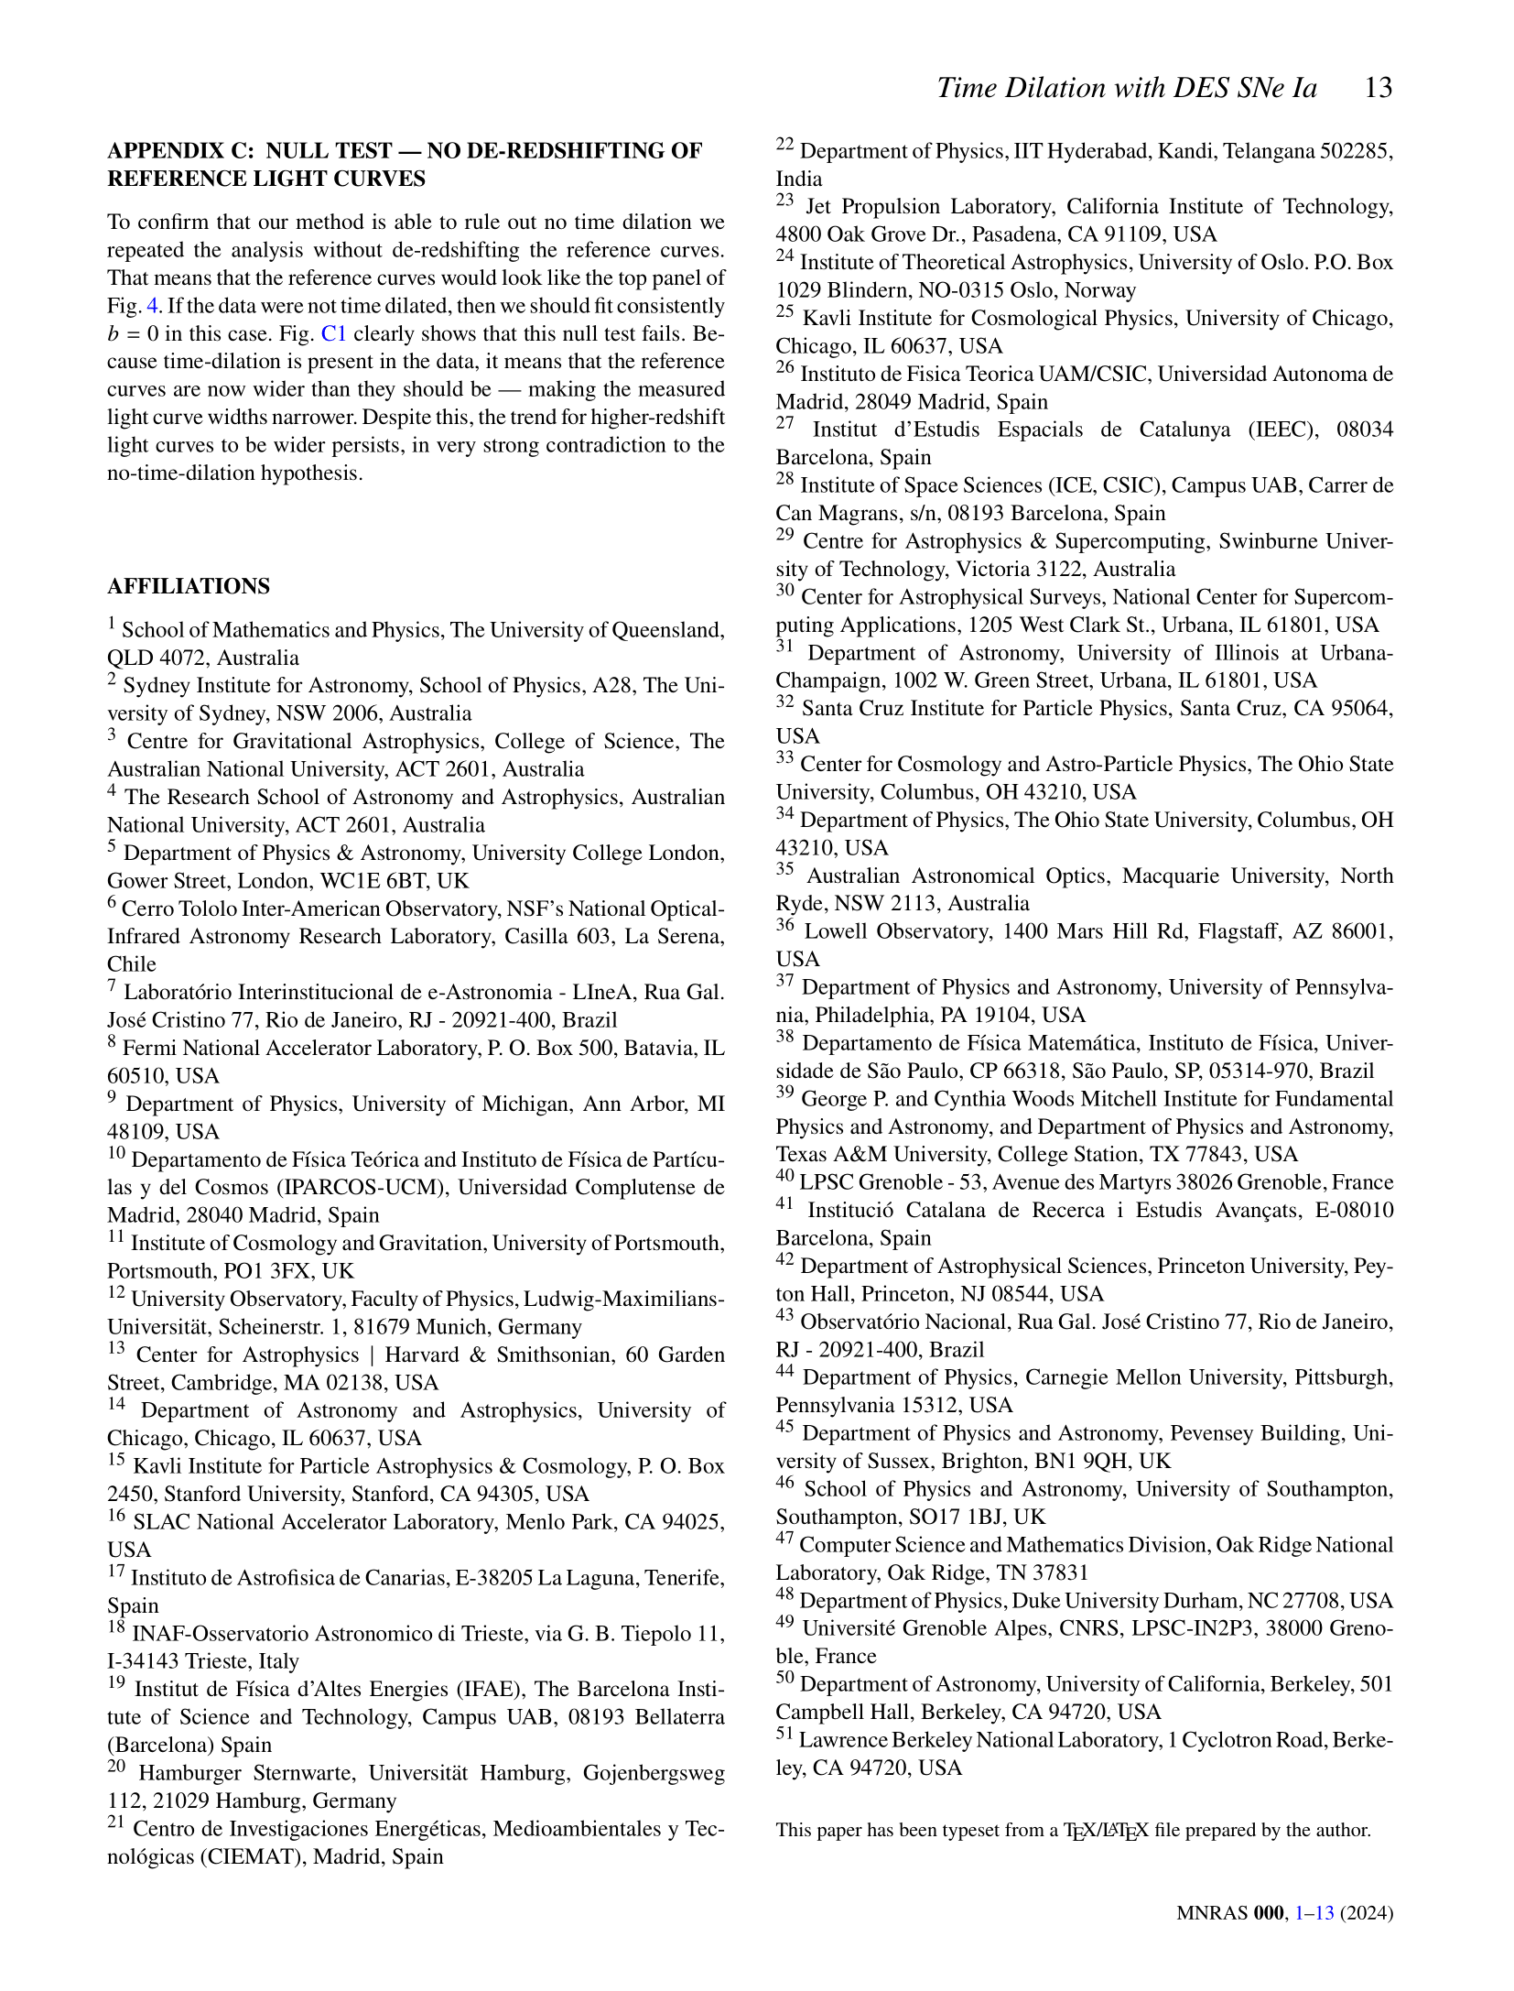

Slide 14
